Slide 1

Leverage AI In Product Management
Discover how AI technologies can transform your daily PM workflow, boost productivity, and enhance decision-making. From creating compelling presentations to analyzing complex data, AI tools are reshaping how product teams work.

Slide 2

GETTING STARTED
How I Got Started with the Project
I began by asking Claude Code a simple but powerful question about improving PM productivity through AI. The goal was to create a comprehensive presentation exploring AI tools that could enhance our daily work—from product presentations and marketing collateral to business analysis and customer meetings.
"I am going to create a 1-hour long presentation to share with my team on how to use AI to improve productivity in Product Management roles. Our daily work involves creating product presentations and marketing collaterals (blogs, videos etc), making product & packaging analysis and decisions, analyzing business data, meeting with internal teams and external customers. I would like to have you give me a plan on the content I should include in my presentation. I would also like you to point out AI tools I should explore to see if they can help with the tasks we have daily. Rank the tools you recommend and provide web link."
This initial prompt set the foundation for discovering practical AI solutions tailored to PM needs.

Slide 3
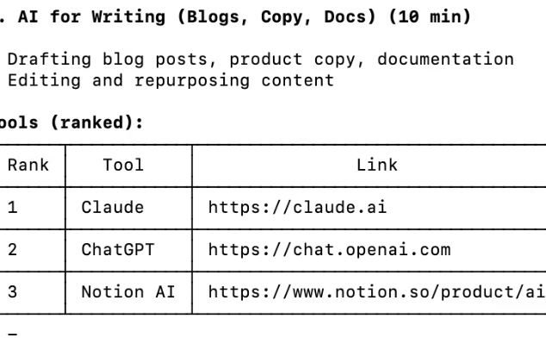
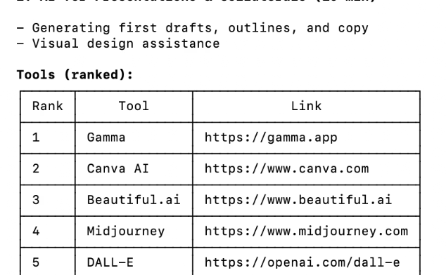
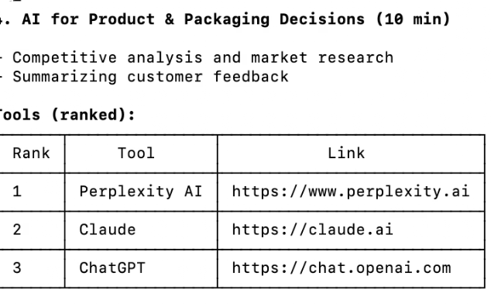
AI RESPONSE
Claude's Comprehensive Analysis
Claude Code delivered an extensive breakdown of AI tools and implementation strategies. The response covered everything from content creation platforms to data analysis solutions, each ranked by relevance and impact for product management workflows.
Presentation Tools
Analysis Solutions
Collaboration Platforms
Advanced analytics tools for product decisions and business intelligence
AI-powered platforms for creating compelling product decks and marketing materials
Smart meeting assistants and team communication enhancers

Slide 4
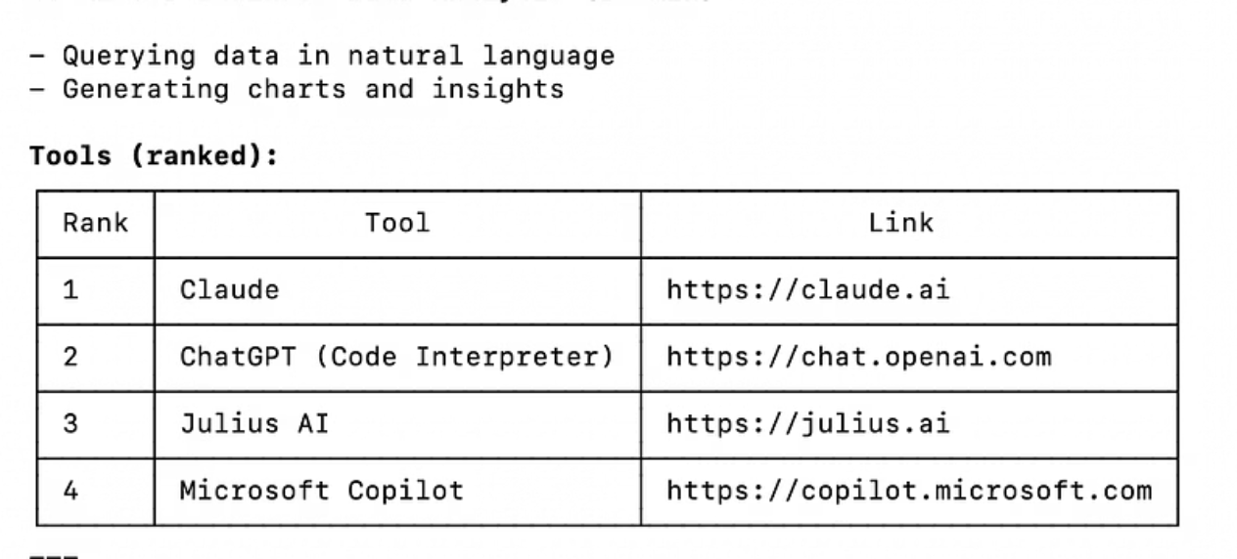
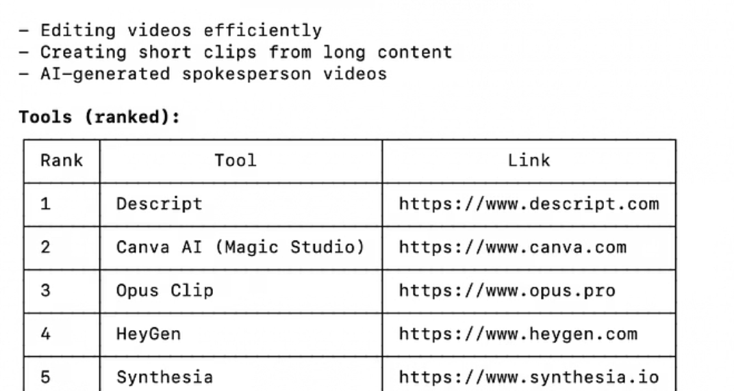
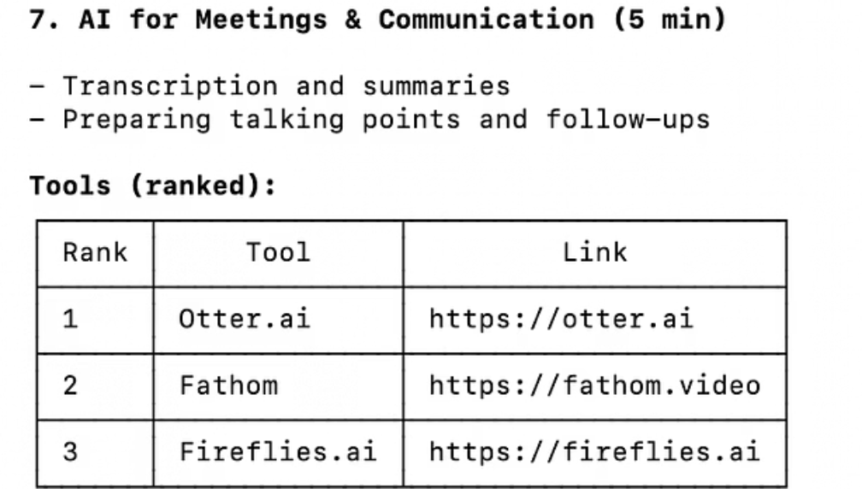
TOOL CATEGORIES
AI Tools Across PM Workflows
The recommendations spanned multiple categories, each addressing specific pain points in product management. From automating routine tasks to generating insights from complex datasets, these tools represent the cutting edge of PM productivity enhancement.
01
02
Content Creation
Data Analysis
Tools for presentations, blogs, videos, and marketing materials
Business intelligence and product analytics platforms
03
04
Communication
Decision Support
Meeting transcription and team collaboration solutions
AI assistants for strategic planning and prioritization

Slide 5
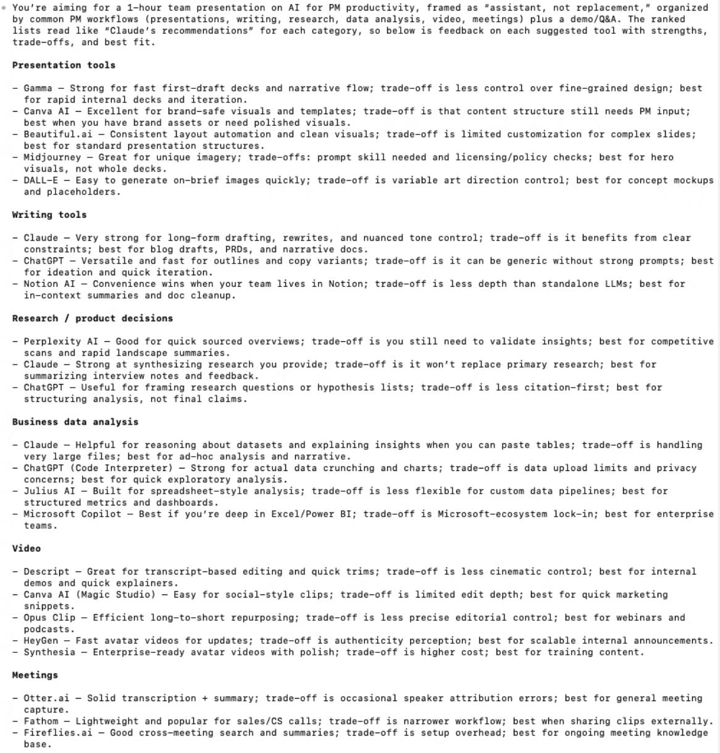
REFINEMENT
Then I Asked Codex to Provide Feedback
As usual, Codex is very thorough…
The initial response was comprehensive but perhaps too broad. Rather than implementing every suggestion immediately, I took a more strategic approach.
So I asked Codex to interview me to create a customized list…
This interactive approach helped narrow down the most relevant tools based on our team's specific workflows, pain points, and technical capabilities. The result was a curated, actionable toolkit rather than an overwhelming catalog.

Slide 6


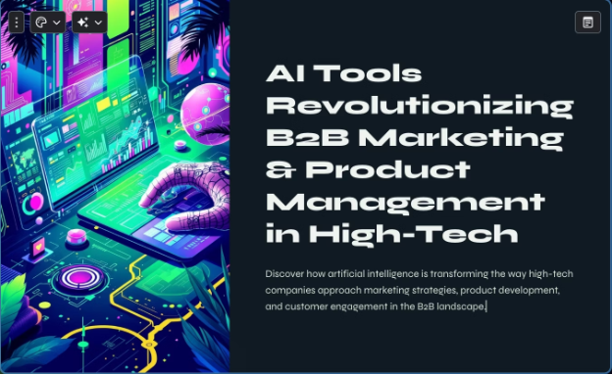

TOOL SPOTLIGHT
Gamma: AI-Powered Presentations
First Impressions
Subscription Model
Sign-up process is slower than competitors
Impressively quick outline and presentation generation
Pricing based on number of slides (called "cards") and design mode access. This usage-based approach allows teams to scale their investment with actual needs.
Export flexibility: PowerPoint, PDF, and PNG formats
Image generation quality needs improvement
User interface is intuitive and fairly easy to navigate
Try it yourself: Visit gamma.app to experience AI-powered presentation creation. Perfect for PMs who need to create compelling decks quickly without sacrificing quality.

